Slide 1


Job portal dataset visualization
Oeson Data Science Internship Project 2
By
Phoenix Campbell

Slide 2

Contents
Description of Project
Descriptive Statistics
Data Visualization including graphs
Code Snippets
Conclusion
4
5
1
3
2

Slide 3

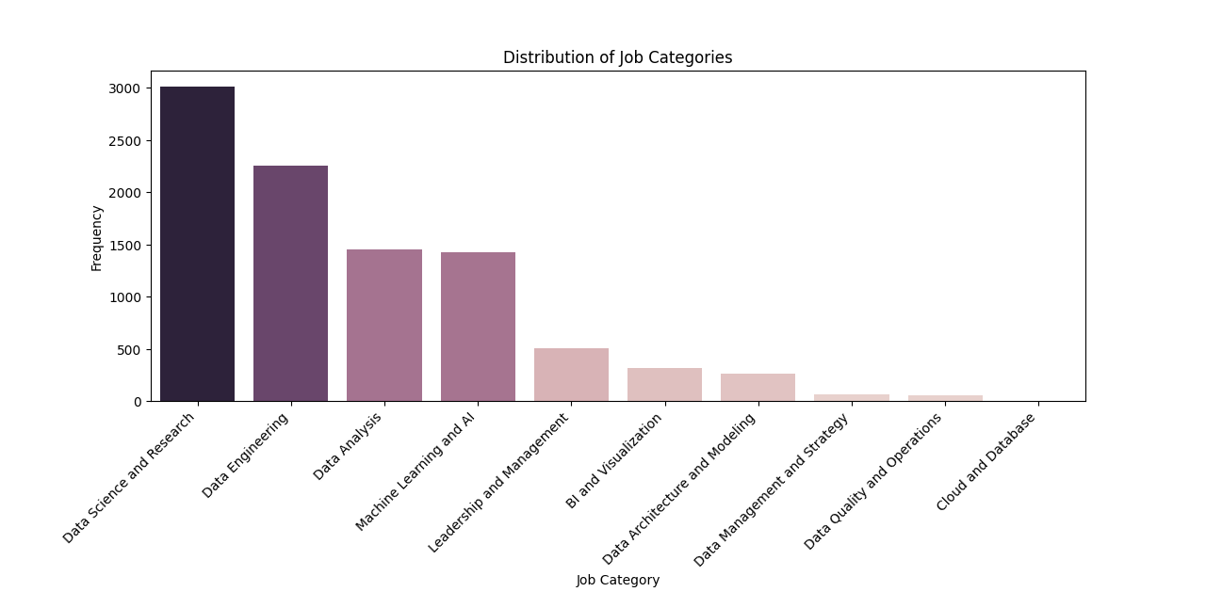

Project Description
I was given a dataset extracted from a famous job portal that explains the job status of various data-related jobs posted during the year 2023. The data explains the various job designations and related salaries from across the world. My job was to extract meaningful insight from this data to explain the actual renumeration each job title provided across the globe. The data had the following headings to be used along with my Python program to extract data: work_year, job_title, job_category, salary_currency, salary, employee_residence, experience_level, employment_type, work_setting, company_location, company_size.

Slide 4
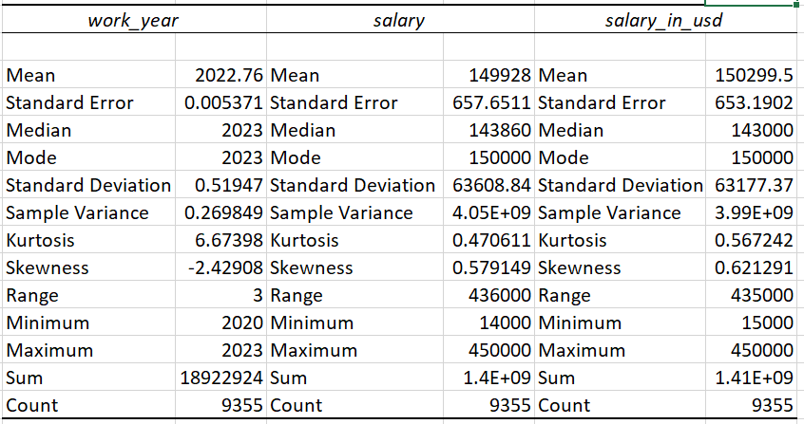
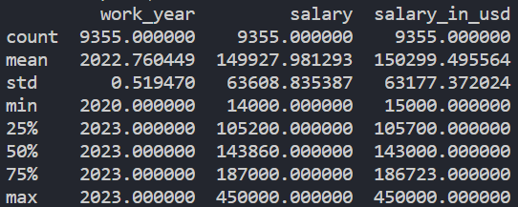
Descriptive Statistics
Discriptive stats and how they are presented can be different between different softwares. Given below is both the descriptive stats given by both Excel and Python using Pandas. While the information provided is the same, both provide the data in different levels of importance. For instance, while I might use Excel for more in depth information where needed, I would prefer Python’s output where I needed quick results such as salary min/max or finding out how much the mean salary in USD is ($150,299.50).This is an interesting statistic considering the large amount of data present.

Slide 5

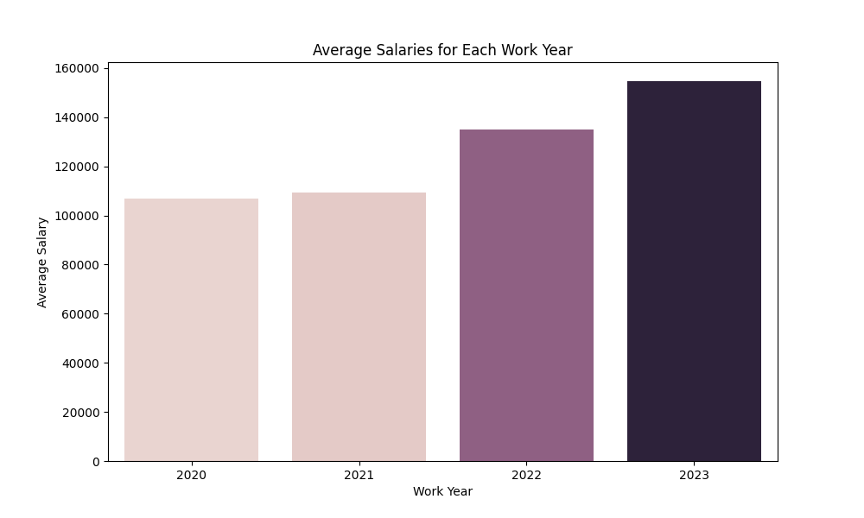
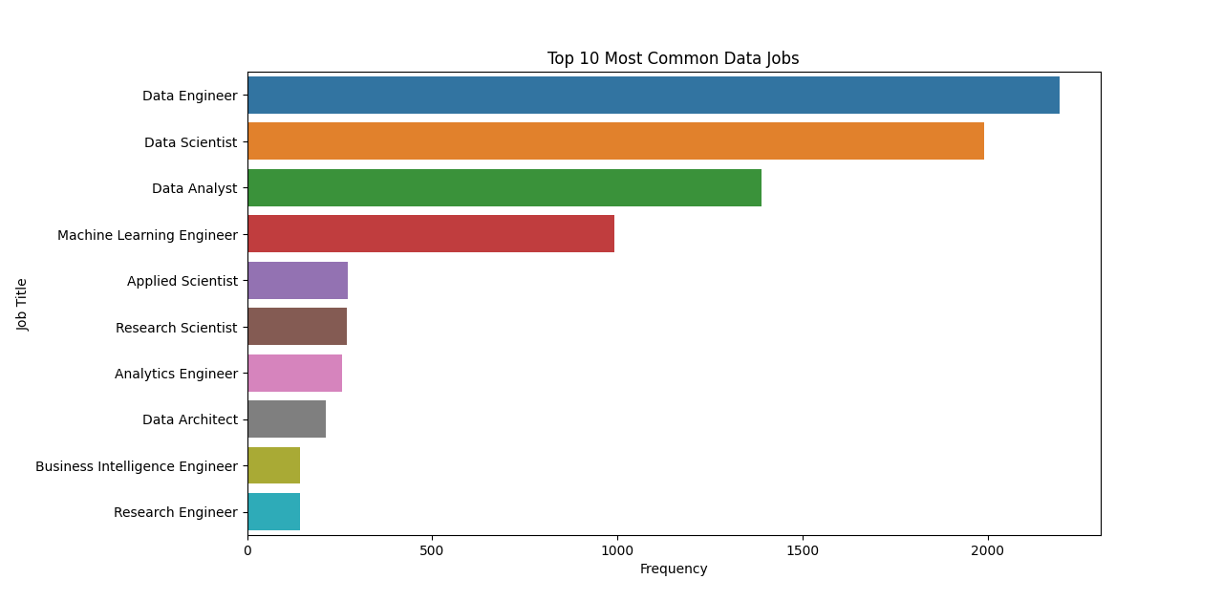
Data visualization
I have included below as well in the next few slides a few of the key graphs that were asked of, along with descriptions of data.
Average salary over the last four years are shown here. As is shown, the average salary overtime has not only grown, but has grown at an exponential rate. More then likely, these fields will continue to grow in this positive way heading into the future.
This graph shows job types and job title commonality as reported. Many job titles are identified as data engineers and is popular along with the title data scientist by a far shot.

Slide 6
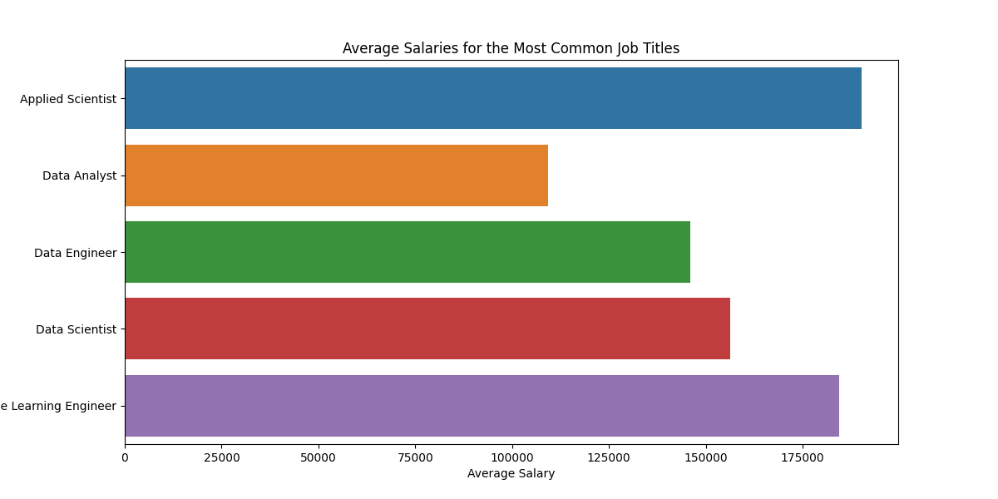
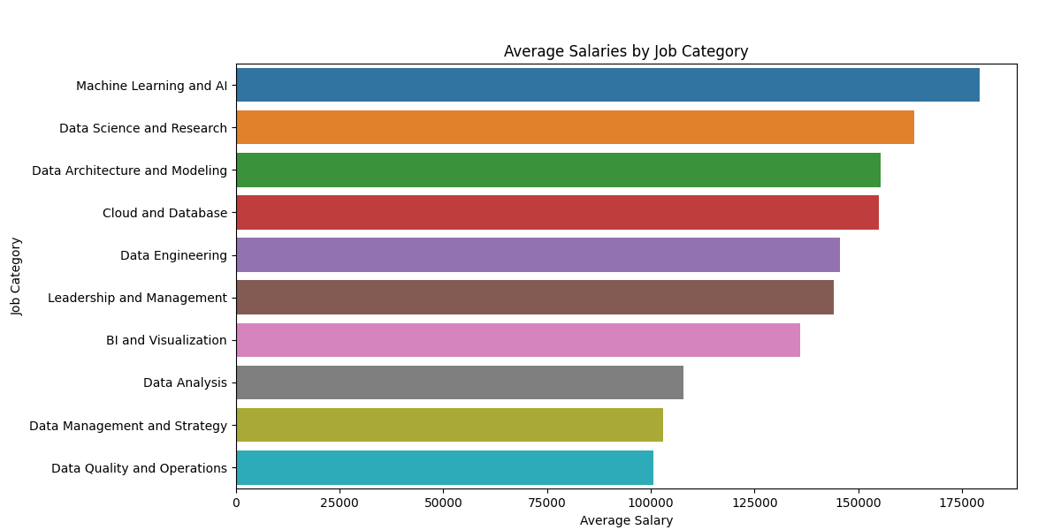
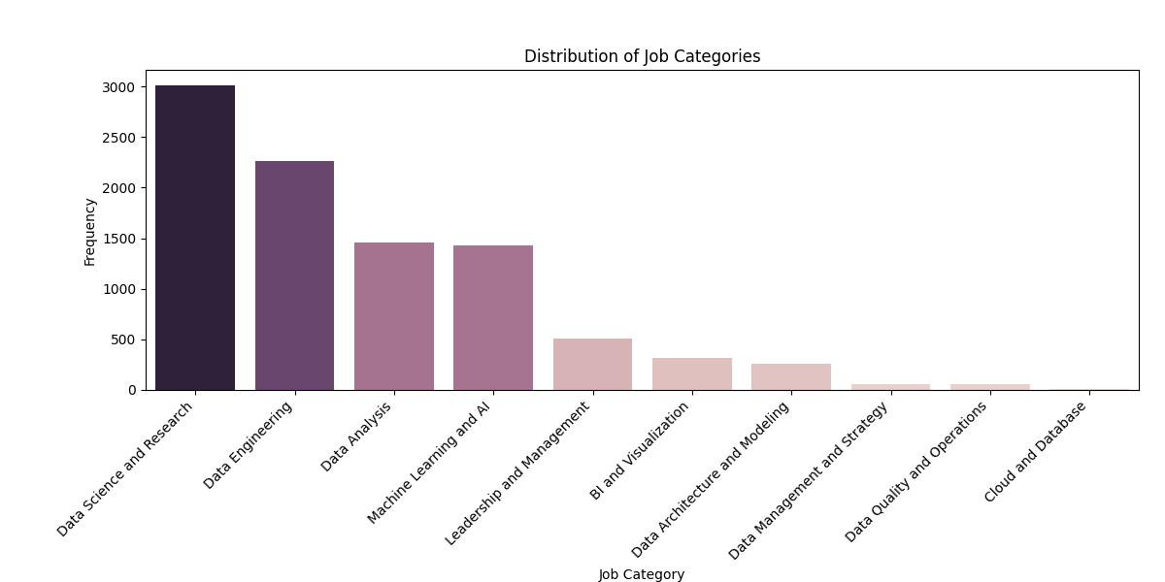
Data visualization cont.
Also pictured below is the job categories. In terms of frequency, many jobs are put as data science and research which seems logical. The other categories are interesting as well knowing that there is a large spread of possible paths.
Pictured above is the average salaries by job category. Using this data along with the data present at the left, while Machine learning and AI is only fourth highest, it has the highest salary of all categories present. This is the importance of multiple graphs and cross-referencing information.
Average salaries by common job titles seem at first glance close to each other. Understanding though that the chart is ticked out by 25000 allows us to see there is still a large gap from the highest point to the lowest point.

Slide 7
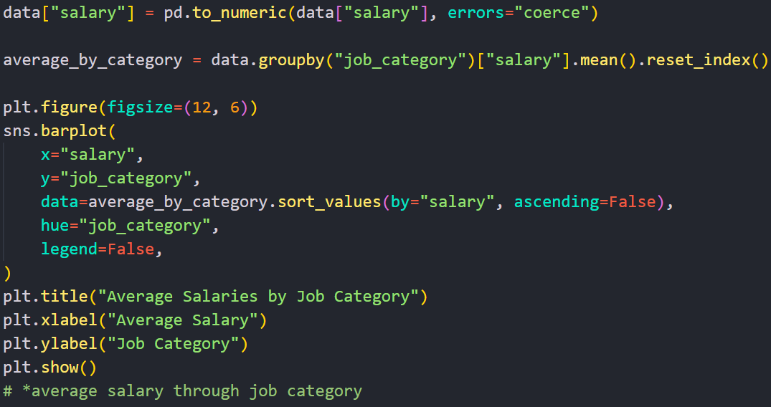
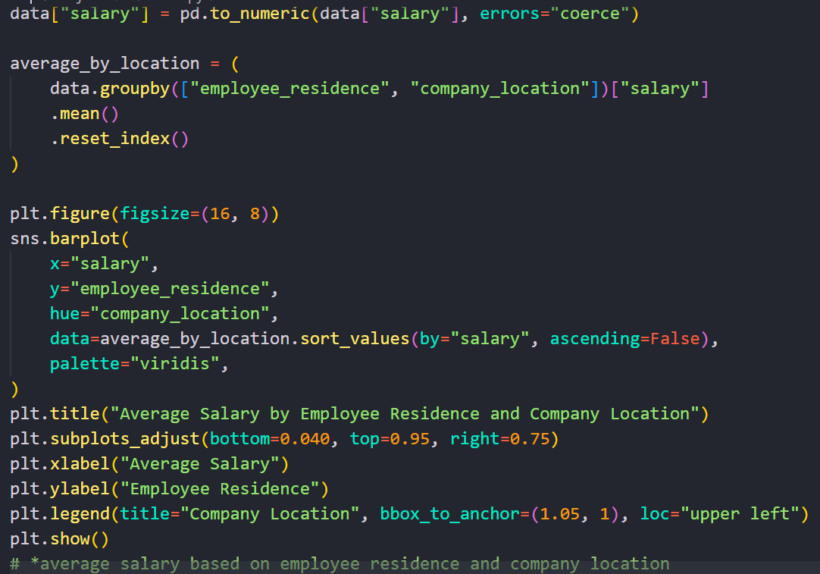
Code Snippets
Showing these different parts of the code allows us to see the complexity as well as the simplicity that we can go into when using a data set. While above is as simple as printing a bar plot, the right code segment groups data, sorts it by salary, adjusts it to be all seen on screen, and prints it in color to be easily readable.

Slide 8
Conclusion
From this information, what can we learn?
While a large dataset can be a monstrous task when looked at originally, it can be broken down simply knowing what to look for and what to use as the medium of presentation. While many fancy graphs can be used like violin graphs, scatterplots, and cat-whisker plots, what you are trying to do as a data analyst and data scientist is to make it as clear as possible. This can be as simple as using barplots to explain large pieces of data and explain it to a common person that will not understand a lot of bells and whistles.
We also learn very important parts from the graph. While data engineering and data scientist roles were very common, they did not earn the most among all job categories. Also average salaries in USD were far higher then other currencies, at almost $160,000. This gives us incites that operating and working with US companies and those that work with US companies data are very profitable compared to other countries.

Slide 9
Thank you for your time.
Phoenix Campbell – Oeson Data Scientist Intern
Gmail – phjcampbell18@gmail.com
LinkedIn - www.linkedin.com/in/phoenix-campbell-144b6228a
Github - https://github.com/PhoenixCampbell/Project_2_Oeson

